Slide 1

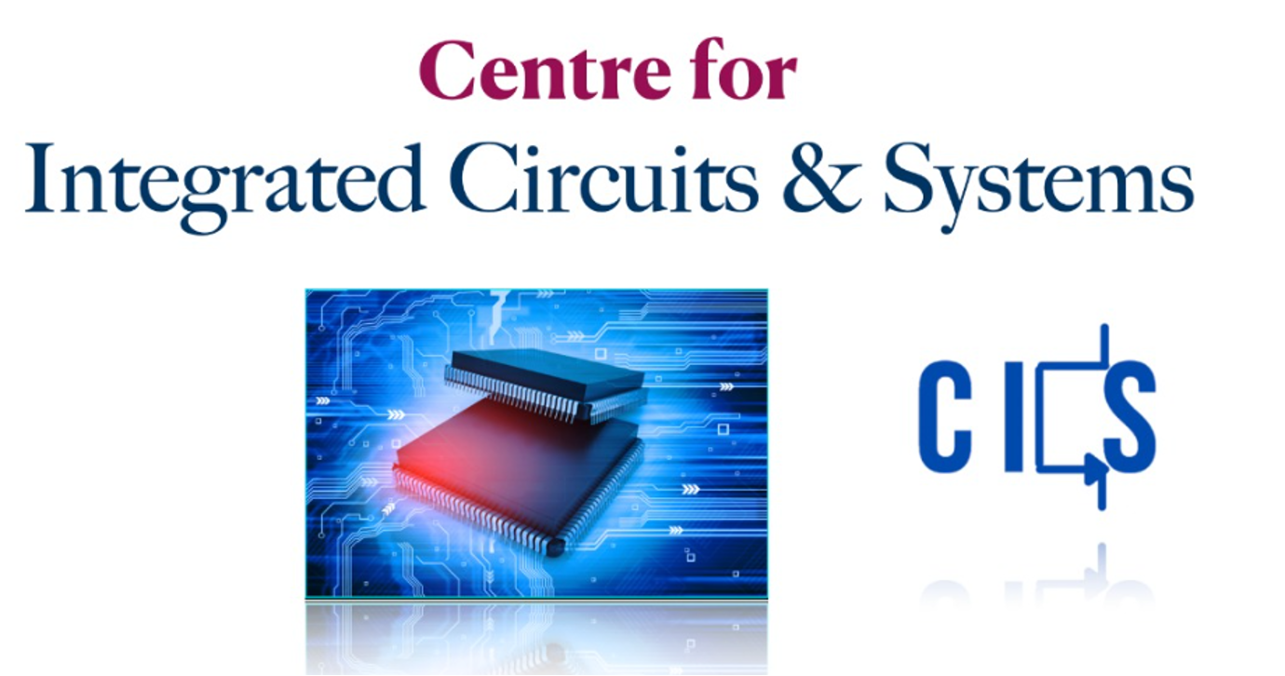
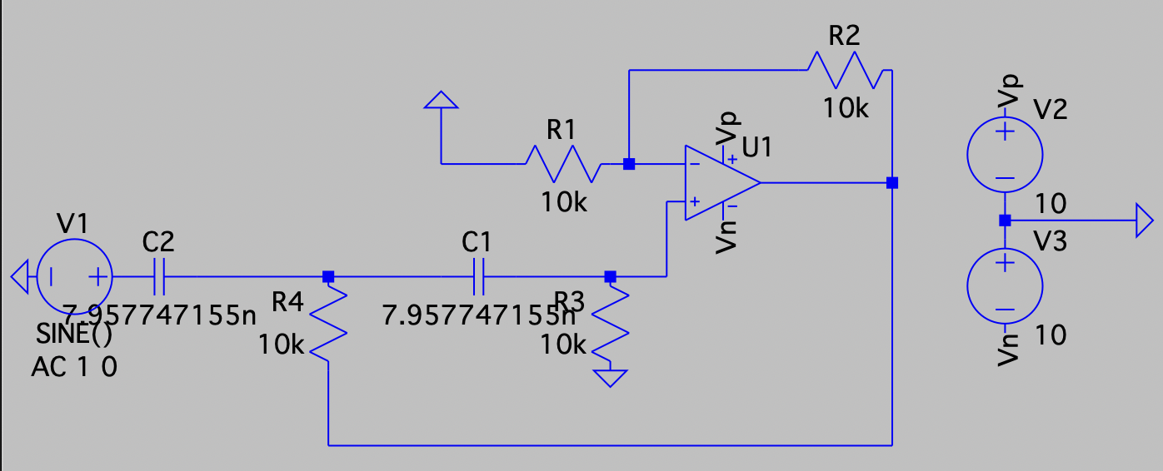
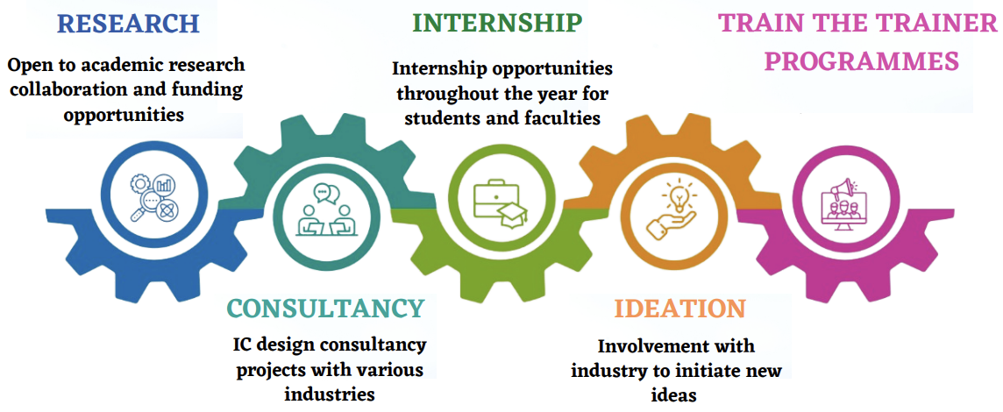
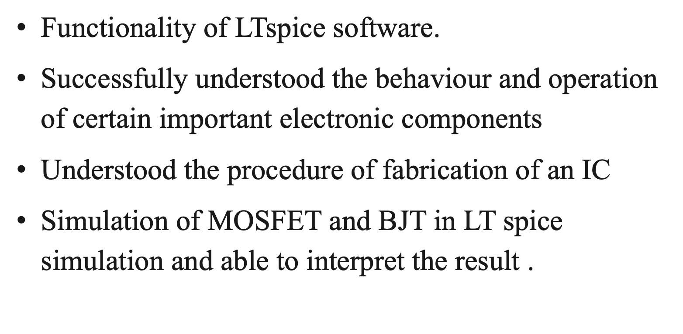
RV College of Engineering
Design and Analysis of Analog & Digital Circuits
Pradyumna S Athreya (1RV21EC119)
Go, change the world
Department of Electronic and Communication Engineering
RV College of Engineering, Bangalore – 560059, INDIA
Profile of the Organization
Activities of the Department
Tasks Performed
Centre for Integrated Circuit and Systems is a Centre of Excellence at RVCE, Bengaluru.
Work on Analog Design, Digital Design, Mixed Signal Design and RF Design
Workshop on LTspice simulation software.
Analysis and simulation of circuits in LTspice software.
Quiz on the sessions conducted.
Webinar on MOSFET Fabrication addressed by Ms. Sabiha Sultana, Prof., IISc.
Visit to IDRC Lab.
Team project to design RC Coupled Amplifier
Provide internship to undergraduate and postgraduate students
Invited talks, consultancy projects with Lekha Wireless Solutions Inc.
MoU’s with several leading tech companies
Paper publications in the field of IC & system design
Reflections
Acknowledgements
The authors thank Principal and HoD, Department of Electronic and Communication Engineering, RVCE for the kind support received for completion of the project.
Guide Information:
Dr D. R Shilpa

